Slide 1

Lecture 1
Node & NPM

Slide 2

Agenda
Introduction to Node.js
Installation of Node.js environment
Execute code in Node.js environment
Http module
Basic concept of modularity
Modularization in Node.js
NPM & package

Slide 3
Introduction to Node.js

Slide 4
What is Node.js
Node.js is a JavaScript runtime built on Chrome's V8 JavaScript engine.
Node.js Operating environment
Attention:
A browser is the front-end runtime environment for JavaScript.
Node.js is the backend runtime environment for JavaScript.
Unable to call browser built-in APIs such as DOM and BOM in Node.js.
engine
Built in API
fs
path
http
JS built-in objects
querystring
etc…
code to be executed

Slide 5
Installation of Node.js environment

Slide 6
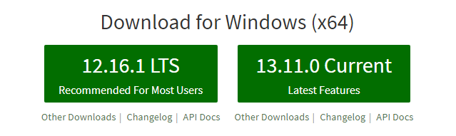
Installation of Node.js
If you want to run JavaScript code through Node.js, you must install the Node.js environment on your computer.
The installation package can be downloaded directly from the homepage of Node.js official website, and can be accessed from the homepage of Node.js official website(https://nodejs.org/en/) Click the green button, download the required version, and double-click to install directly.
LTS is a long-term stable version. For enterprise level projects that pursue stability, it is recommended to install the LTS version of Node.js.
Current is a trial version of new features. For users who are eager to try new features, it is recommended to install the Current version of Node.js. However, there may be hidden bugs or security vulnerabilities in the Current version, so it is not recommended to use the Current version of Node.js in enterprise projects.

Slide 7
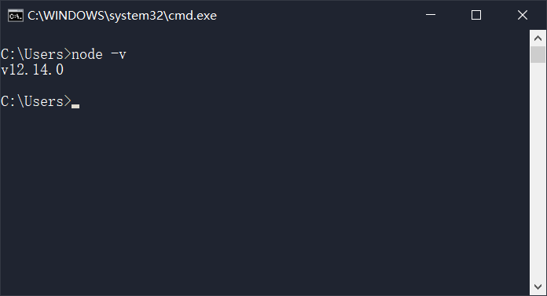
Installation of Node.js
View the version number of the installed Node.js
Open the terminal, enter the command node-v and press enter to view the version number of the installed Node.js.
How to quickly open a terminal on Windows systems:
Use the shortcut key (Windows + R) to open the Run panel, enter cmd and press enter directly to open the terminal.

Slide 8
Execute Code in Node.js

Slide 9
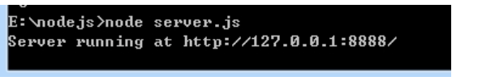
Execute code in Node.js environment
Open terminal
Enter the path to the JS file to be executed by the node
For example, we run and execute a code named server.js

Slide 10
Http Module

Slide 11
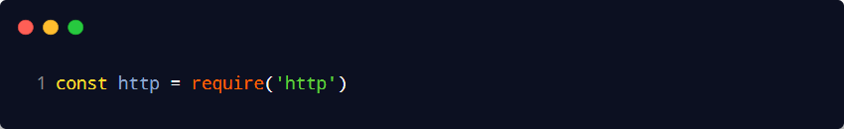
Http Module
What is HTTP module?
Review: What is a client and what is a server?
In a network node, the computer responsible for consuming resources is called the client; The computer responsible for providing network resources to the outside world is called a server.
The HTTP module is an official module provided by Node.js for creating web servers. By using the http. createService() method provided by the HTTP module, it is convenient to turn a regular computer into a web server and provide web resource services to the outside world.
If you want to use web modules to manipulate files in JavaScript code, you need to import it first using the following method:

Slide 12
Http Module
Further understand the role of the HTTP module
The difference between a server and a regular computer is that web server software such as IIS, Apache, etc. is installed on the server. By installing these server software, a regular computer can be turned into a web server.
In Node.js, we do not need to use third-party web server software such as IIS and Apache. Because we can easily write a server software based on the HTTP module provided by Node.js, and provide web services to the outside world with a few simple lines of code.

Slide 13
Http Module
Create the most basic web server
Step 1- Import HTTP module
If you want to create a web server on your own computer to provide web services externally, you need to import the HTTP module:

Slide 14
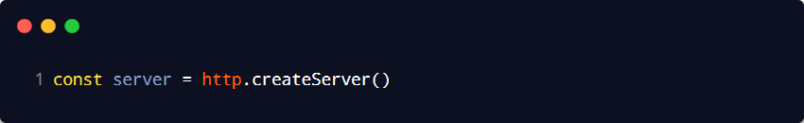
Http Module
Create the most basic web server
Step 2 - Create a web server instance
Call the http.createService() method to quickly create a web server instance:

Slide 15
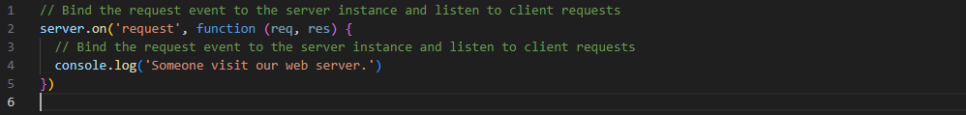
Http Module
Create the most basic web server
Step 3- Bind the request event to the server instance
Bind the request event to the server instance to listen for network requests sent by the client:

Slide 16
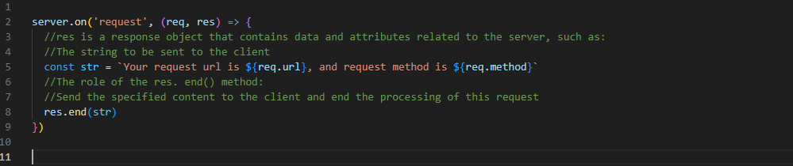
Http Module
Create the most basic web server
Step 4- res Response Object
In the request event handling function of the server, if you want to access data or properties related to the server, you can use the following methods:

Slide 17
Http Module
Respond to different HTML content based on different URLs
Core implementation steps
Get the requested URL address
Set the default response content to 404 Not found
Determine if the user's request is for / or /index.html (homepage)
Determine if the user's request is /about.html (about page)
Use res. end() to respond to the content to the client

Slide 18
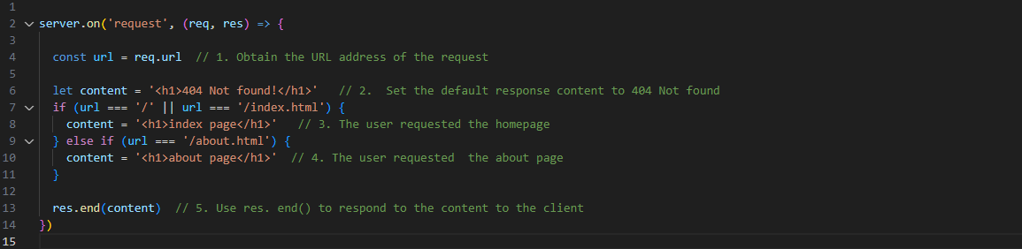
Http Module
Respond to different HTML content based on different URLs
Dynamic response content

Slide 19
Basic concept of Modularity

Slide 20
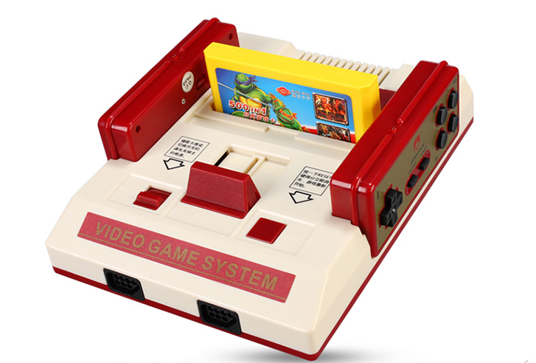

Basic concept of Modularity
What is modularity
Modularization refers to the process of dividing a system into several modules layer by layer from top to bottom when solving a complex problem. For the entire system, modules are units that can be combined, decomposed, and replaced.

Slide 21
Basic concept of Modularity
What is modularity
Modularization in the field of programming
Modularization refers to the process of dividing a system into several modules layer by layer from top to bottom when solving a complex problem. For the entire system, modules are units that can be combined, decomposed, and replaced. In the field of programming, modularity refers to following fixed rules and breaking down a large file into multiple independent and interdependent small modules.
The benefits of modularizing and breaking down code:
Improved code reusability
Improved code maintainability
Can achieve on-demand loading

Slide 22
Basic concept of Modularity
Modularization in the field of programming
Modular specification refers to the rules that need to be followed when breaking down and combining code in a modular manner.
For example:
What syntax format to use to reference modules
What syntax format is used in the module to expose members externally
The benefits of modular specification: Everyone follows the same modular specification when writing code, reducing communication costs and greatly facilitating mutual calls between modules, benefiting both parties and oneself.

Slide 23
Modularization in Node.js

Slide 24
Modularization in Node.js
Classification of modules in Node.js
According to the different sources of modules in Node.js, modules are divided into three categories:
Built in modules (Built in modules are provided by Node.js, such as fs, path, http, etc.)
Custom Module (Each. js file created by the user is a custom module)
Third party module (a module developed by a third party, not an official built-in module or a user-defined module, which needs to be downloaded before use)

Slide 25
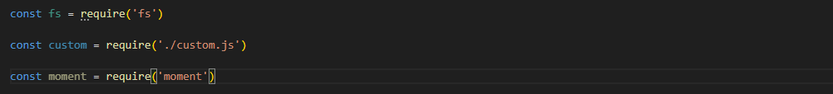
Modularization in Node.js
Load Module
By using the powerful require method, it is possible to load the required built-in modules, user-defined modules, and third-party modules for use. For example:

Slide 26
Modularization in Node.js
Module scope in Node.js
What is module scope
Similar to function scope, variables, methods, and other members defined in a custom module can only be accessed within the current module. This module level access restriction is called module scope.
The benefits of module scope
Preventing global variable contamination issues

Slide 27
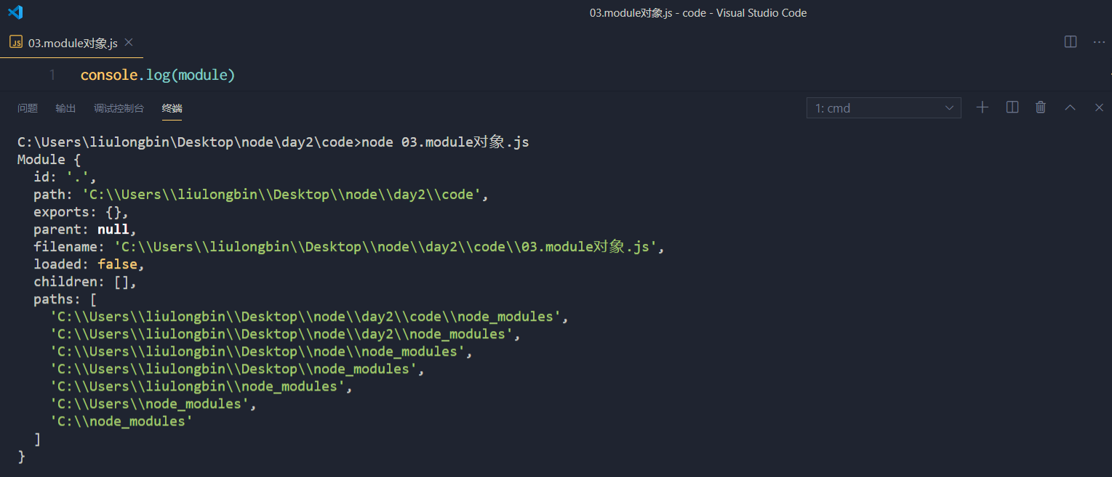
Modularization in Node.js
Share members in the scope of the module externally
module object
In each js custom module, there is a module object that stores information related to the current module, printed as follows:

Slide 28
Modularization in Node.js
Share members in the scope of the module externally
module.exports object
In custom modules, the module.exports object can be used to share the members within the module for external use. When importing custom modules using the request() method, the object pointed to by module. exports is obtained.
Notes when sharing members
When using the request() method to import a module, the result of the import is always based on the object pointed to by module.exports.

Slide 29
NPM & package

Slide 30
npm & package
package
What is a package
The third-party module in Node.js is also called a package.
Just like computers and computers refer to the same thing, third-party modules and packages refer to the same concept, but with different names.

Slide 31
npm & package
package
The source of the package
Unlike the built-in and custom modules in Node.js, packages are developed by third-party individuals or teams and are free for everyone to use.
Note: The packages in Node.js are free and open source, and can be downloaded and used for free without payment.

Slide 32
npm & package
package
Why do I need a package
to the fact that the built-in modules of Node.js only provide some underlying APIs, efficiency is low when developing projects based on built-in modules.
The package is encapsulated based on built-in modules, providing more advanced and convenient APIs, greatly improving development efficiency.
The relationship between packages and built-in modules is similar to the relationship between jQuery and browser built-in APIs.

Slide 33
npm & package
package
Where to download the package
https://www.npmjs.com/ ，It is the world‘s largest package sharing platform, and you can search for any package you need from this website.
https://registry.npmjs.org/ ，We can download the packages we need from this server.
Attention:
From https://www.npmjs.com/ Search for the packages you need on the website
From https://registry.npmjs.org/ Download the package you need from the server

Slide 34
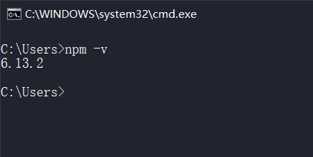
npm & package
package
Where to download the package
NPM, Inc. provides a package management tool that we can use to manage packages from https://registry.npmjs.org/.
The server downloads the required packages for local use.
The name of this package management tool is Node Package Manager (abbreviated as npm package management tool), which is installed on the user's computer along with the Node.js installation package.
You can execute the npm - v command in the terminal to view the version number of the npm package management tool installed on your computer:

Slide 35
npm & package
Initial experience of NPM
The traditional practice of formatting time
Create a custom module for formatting time
Method for defining formatting time
Create a zero padding function
Export a function for formatting time from a custom module
Import custom module for formatting time
Calling the function to format the time

Slide 36
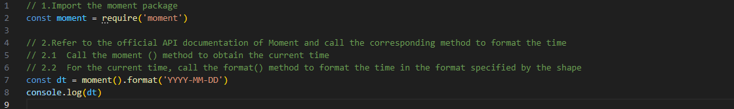
npm & package
Initial experience of NPM
Advanced practices for formatting time
Use the NPM package management tool to install the formatted time package moment in the project
Import a formatted time package using request()
Refer to the official API documentation of Moment to format the time

Slide 37
npm & package
Initial experience of NPM
Command to install packages in the project
If you want to install a package with the specified name in the project, you need to run the following command:
The above packaging command can be abbreviated in the following format:

Slide 38
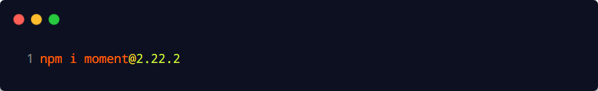
npm & package
Initial experience of NPM
Install the specified version of the package
After the initial packaging is completed, add an additional folder called node.modules and a configuration file for package lock.json in the project folder. By default, when using the npm install command to install a package, the latest version of the package will be automatically installed. If you need to install a specified version of the package, you can specify the specific version using the @ symbol after the package name, for example:

Slide 39
npm & package
Initial experience of NPM
What additional files were added after the initial packaging
After the initial packaging is completed, add an additional folder called node.modules and a configuration file for package lock.json in the project folder.
The node_modules folder is used to store all packages installed in the project. When importing third-party packages, request() searches for and loads the package from this directory.
The package-lock.json configuration file is used to record the download information of each package in the node.modules directory, such as the package name, version number, download address, etc.
Note: Programmers should not manually modify any code in the node.modules or package lock.json file, as the NPM package management tool will automatically maintain them.

Slide 40
npm & package
Package Management Profile
According to NPM regulations, a package management configuration file called package.json must be provided in the project root directory. Used to record some configuration information related to the project. For example:
The name, version number, description, etc. of the project
What packages were used in the project
Which packages will only be used during development
Those packages need to be used during development and deployment

Slide 41
npm & package
Package Management Profile
Quickly create package.json
The NPM package management tool provides a shortcut command to quickly create a package.json package management configuration file in the directory where the command is executed:

Slide 42
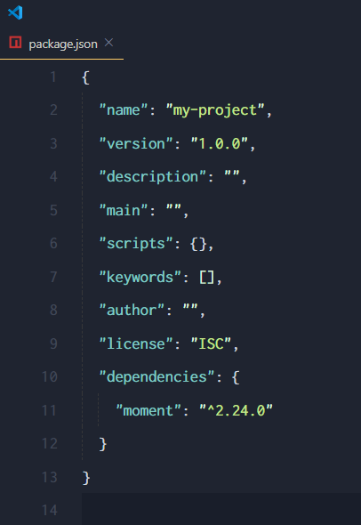
npm & package
Package Management Profile
Dependencies node
In the package.json file, there is a dependencies node specifically used to record which packages you installed using the npm install command.

